Slide 1
Football Team Logo Classification Using CNNs
Borjan Petrevski 106/2022 Prof. Dr. Hristijan Gjoreski

Slide 2

Introduction
Football team logos are highly distinctive but vary in color, shape, orientation, and style
This project explores how Convolutional Neural Networks (CNNs) can learn visual patterns in football logos
Automatic logo recognition is a challenging computer vision task
The focus is on multi-class image classification using deep learning

Slide 3
Project Objectives
What is this project about?
Build a CNN-based model to classify football team logos
Train the model on La Liga team logos
Apply transfer learning to classify Serie A team logos
Evaluate performance using:
Accuracy
Confusion Matrix
Classification Report

Slide 4

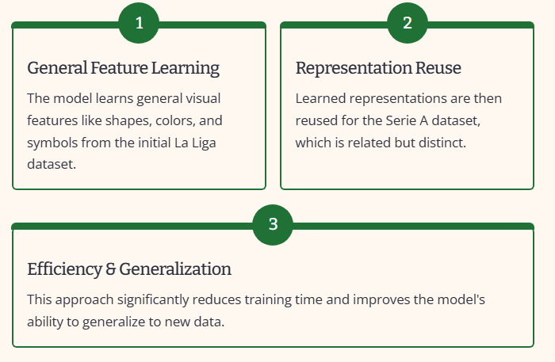
Leveraging Transfer Learning

Slide 5

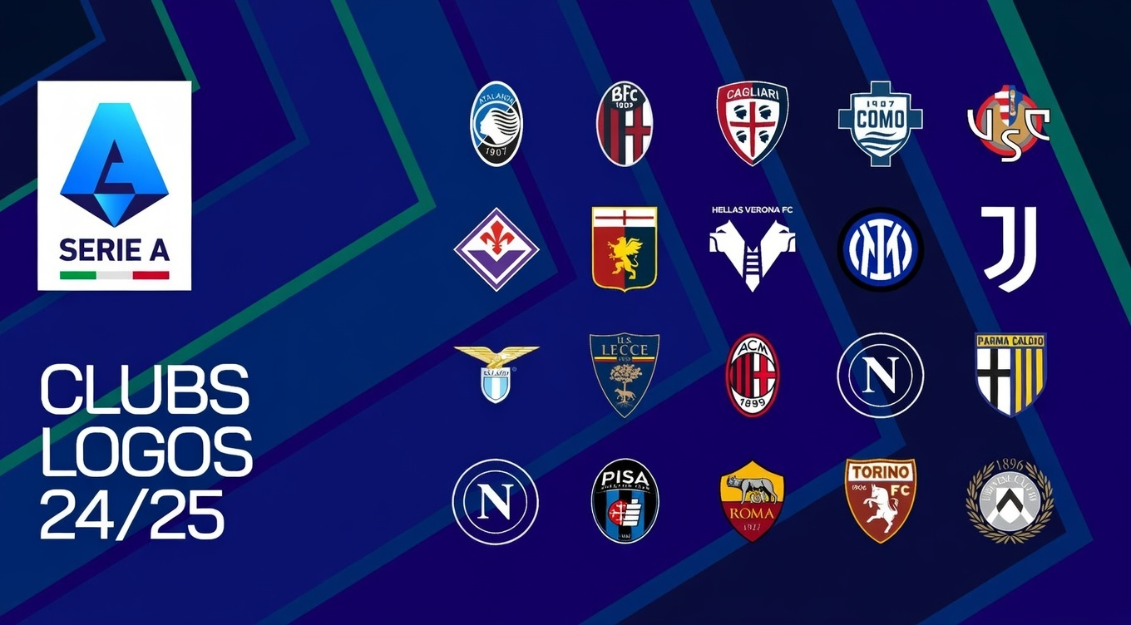
Datasets Overview
La Liga Dataset
Contains official club logos from Spanish football teams, organized in separate folders per team. Used to train a CNN from scratch and learn general logo features.
Serie A Dataset
Comprises Italian football club logos. Used after the La Liga model is trained to apply transfer learning and evaluate generalization to a new league.

Slide 6
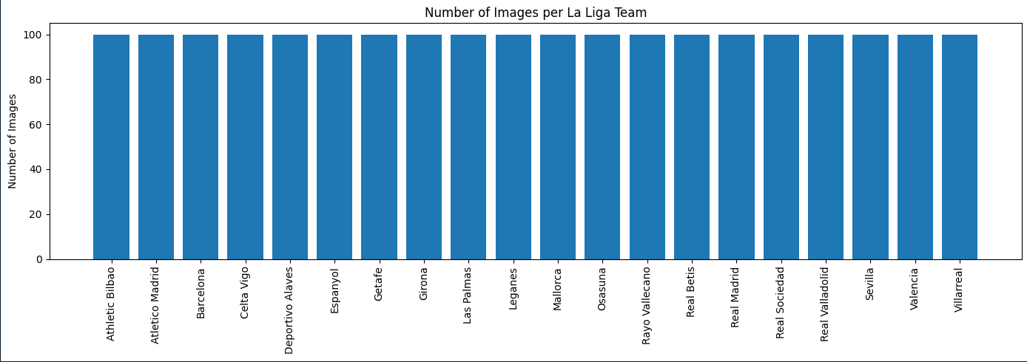
Data Exploration

Slide 7
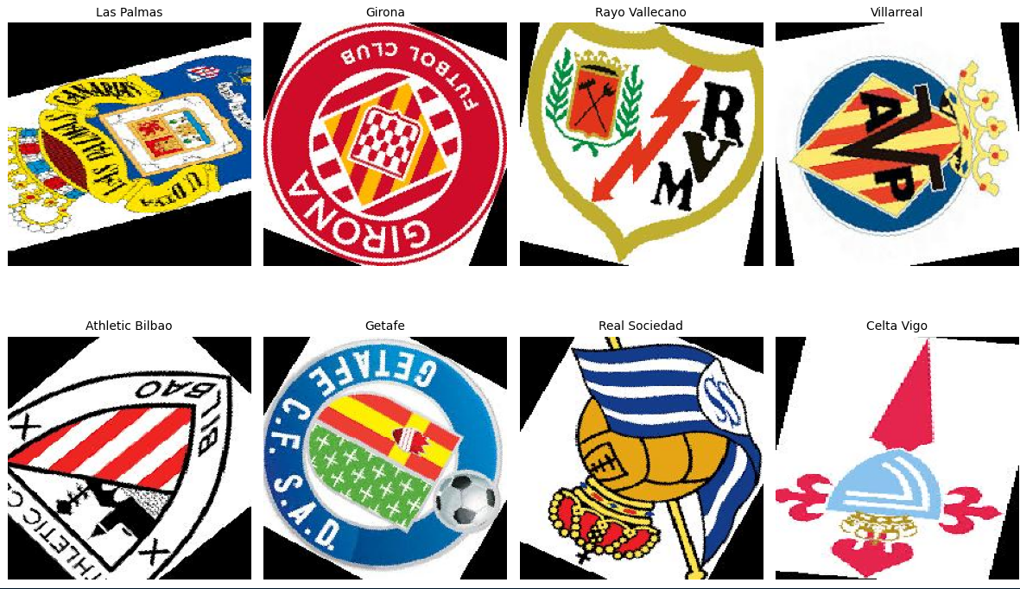
Initial Images before rescaling and reshaping

Slide 8
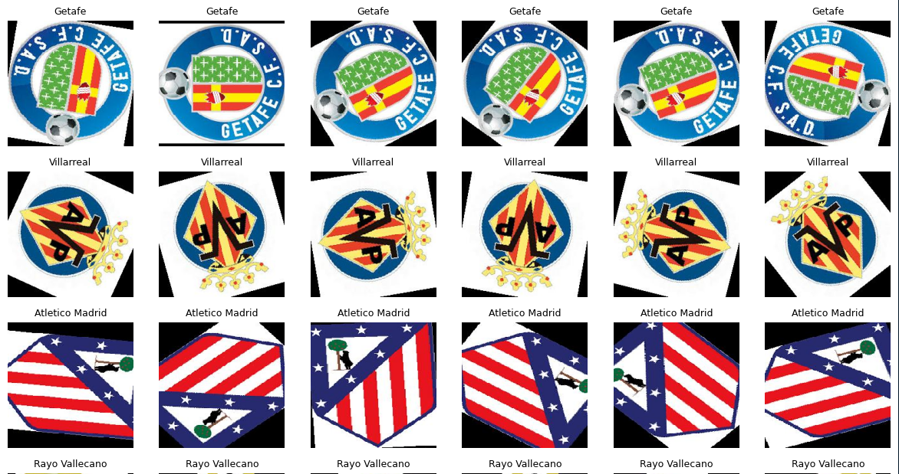
Random rotations of the images

Slide 9
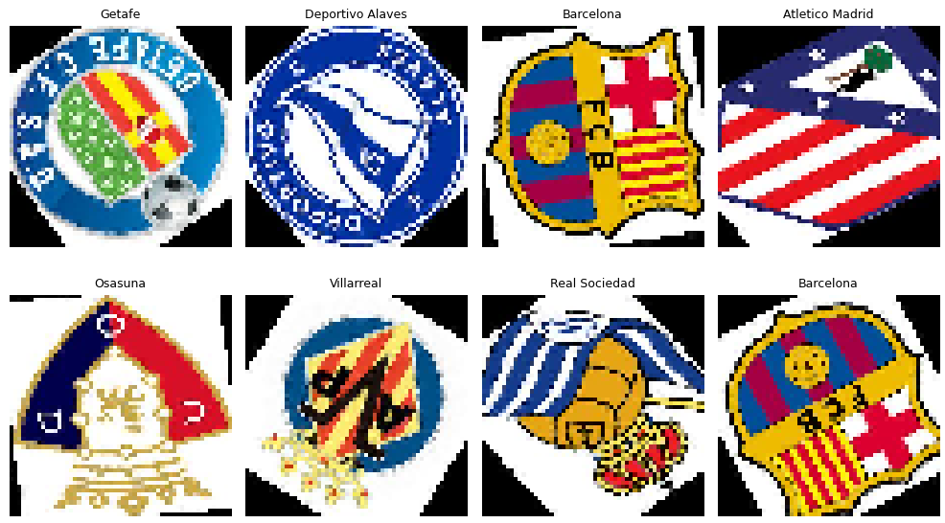
Data Preprocessing
All images resized to 56 × 56 pixels
Pixel values normalized to range [0, 1]
Dataset split:
Training
Validation
Testing (for Serie A)

Slide 10
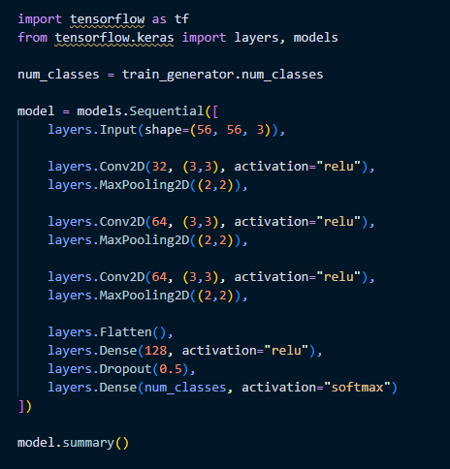
Baseline CNN Model Architecture
Convolutional Neural Network consisting of:
Convolution + MaxPooling blocks for feature extraction
Fully connected layers for classification
Dropout for regularization
This model serves as the baseline trained on La Liga logos.

Slide 11
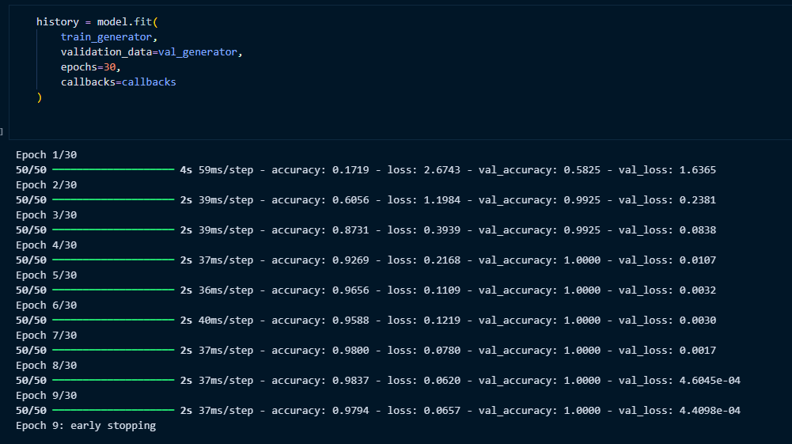
Training the baseline model

Slide 12
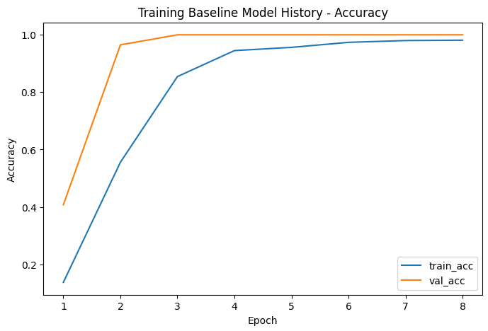
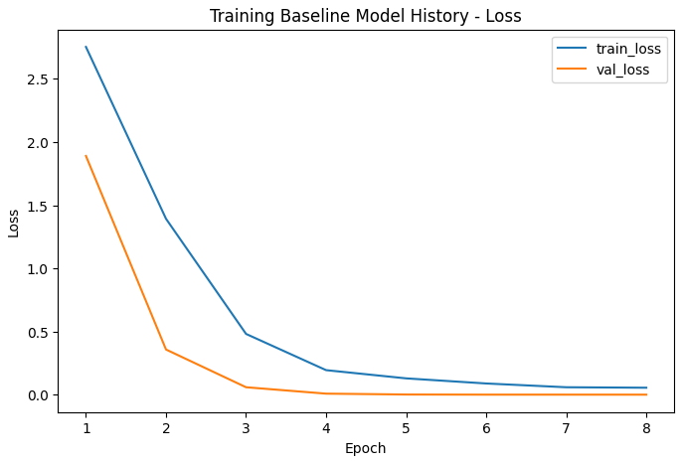
Training Curves

Slide 13
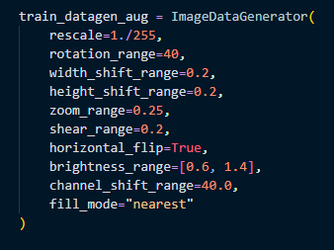
Applying Data Augmentation
To improve generalization and reduce overfitting, data augmentation is applied only to the training set.
Augmentations include:
Rotation
Translation
Zoom
Shear
Horizontal flipping
This helps the model become invariant to orientation and scale changes.

Slide 14
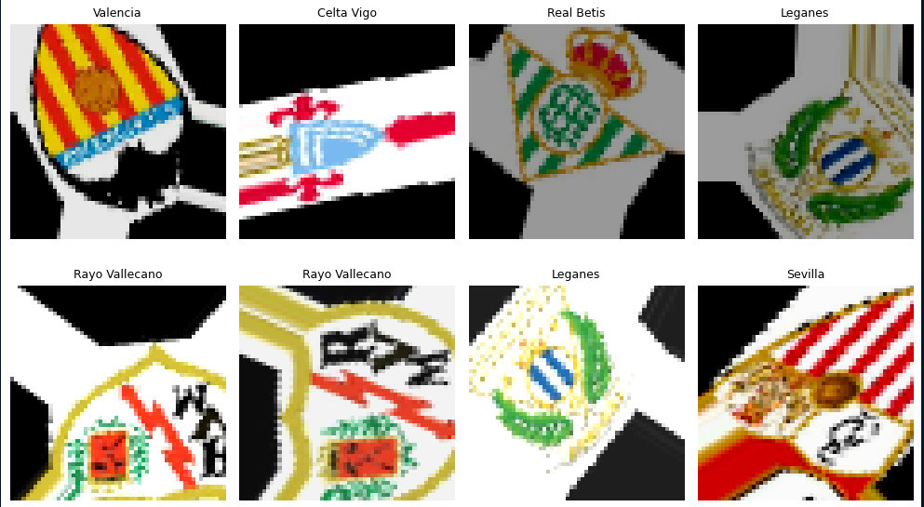

Slide 15
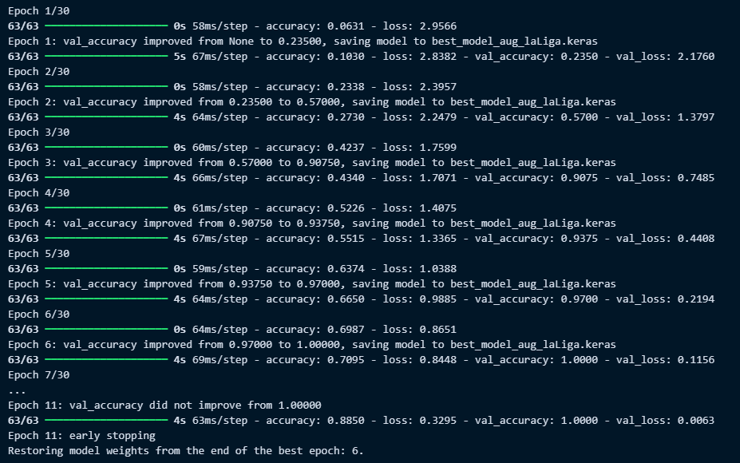
Training with Data Augmentation
The same CNN architecture is retrained using augmented data.
This “typically” improves robustness and reduces overfitting compared to the baseline model.

Slide 16
Transfer Learning Strategy
From La Liga to Serie A
Pretrained La Liga CNN used as feature extractor
Convolutional layers frozen
New classification head added:
Dense layer
Dropout
Softmax output for Serie A teams
Creating Train, Validation, and Test Splits
To properly evaluate model performance and avoid data leakage, the dataset is
manually split into three subsets:
- Training set (70%) – used to learn model parameters
- Validation set (15%) – used for hyperparameter tuning and early stopping
- Test set (15%) – used only for final evaluation

Slide 17
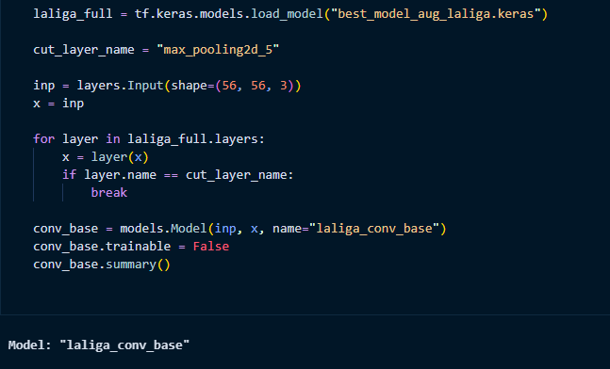
Creating a Frozen Convolutional Base
To apply transfer learning, I reuse the convolutional layers of the trained La Liga model
as a fixed feature extractor. The model is truncated at the last convolutional block,
removing the original classification head.
Here, we iterate through the layers of the pretrained La Liga model and stop at a chosen
convolutional layer.

Slide 18
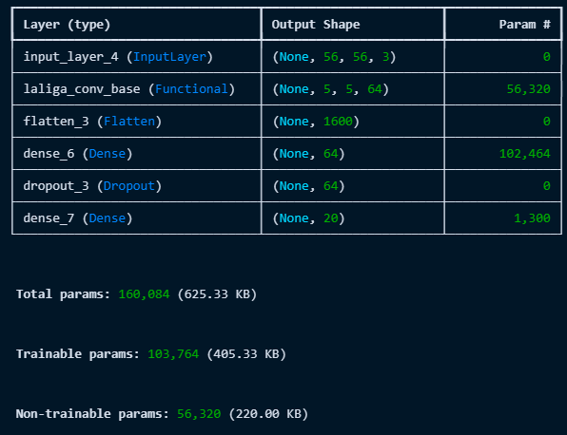
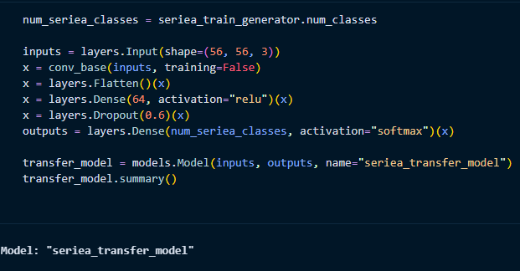
Building the Serie A Transfer Learning Model
A new classification head is added on top of the frozen convolutional base.
This head consists of:
- A flattening layer to convert feature maps into vectors
- A dense layer with ReLU activation
- A dropout layer for regularization
- A final softmax layer for multi-class classification

Slide 19
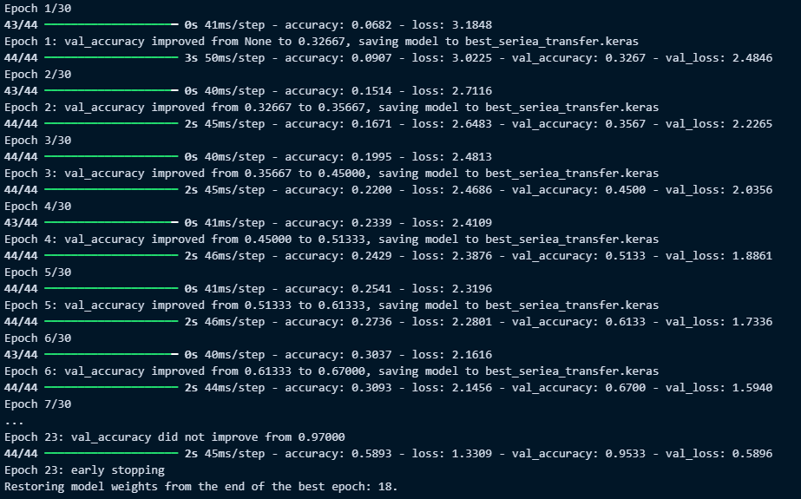
Training the Transfer Learning Model

Slide 20
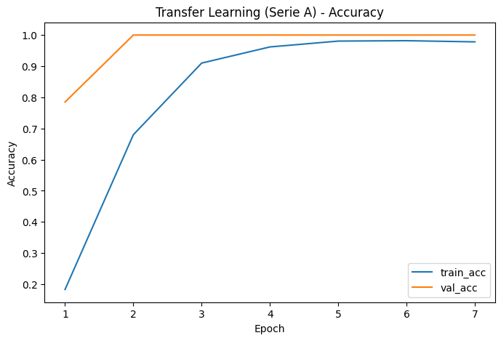
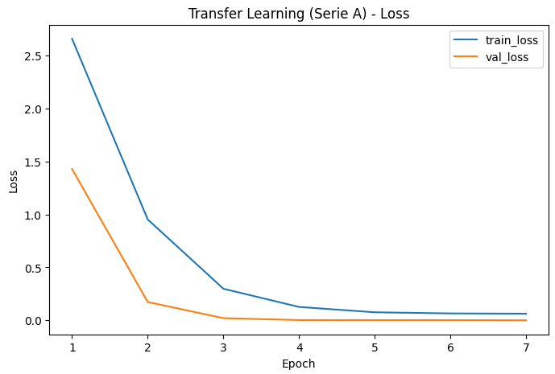
Training Curves

Slide 21
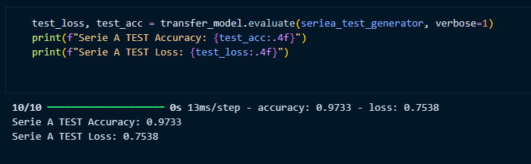
Evaluating the Model on the Test Set

Slide 22
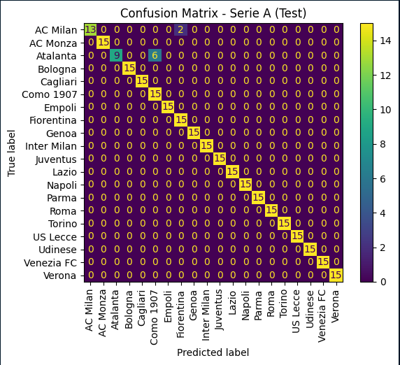
Confusion Matrix Analysis

Slide 23
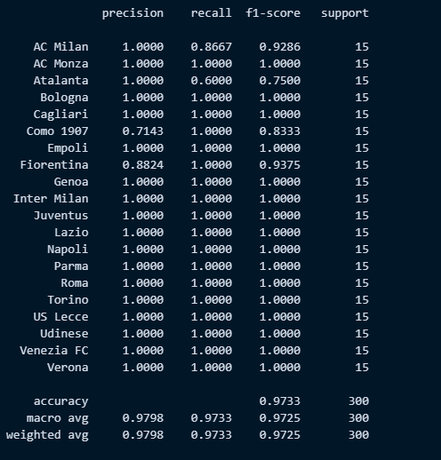
Classification Report

Slide 24
Summary & Conclusions
This project demonstrated that Convolutional Neural Networks (CNNs) are highly effective for football team logo classification, even with relatively small input images.
The model successfully learned distinct visual features such as shapes, colors, and emblem structures, achieving high accuracy (~97%) on the Serie A test set.
Techniques used to reduce overfitting:
Extensive data augmentation
Dropout layers in the classifier
Early stopping and model checkpointing
Freezing convolutional layers during transfer learning
Potential improvements to further reduce overfitting:
Increase dataset size with more leagues or seasons
Fine-tune deeper convolutional layers with a lower learning rate
Apply stronger regularization techniques

